Slide 1

Online Remote Proctored examination-TEE June, 2026 for E-Vidya Bharti Learners
Demonstration
By
SED, RSD and COE
IGNOU

Slide 2
In this Session…..
Demo Video Link: https://youtu.be/kgZNN0DHau4
Pre-Examination Instructions to EVBAB Students;
Online Remote Proctored Examinations;
UFM
Control and Monitoring by IGNOU.
Demo Video Link: https://youtu.be/kgZNN0DHau4

Slide 3
Pre-Examination Instructions to EVBAB Students

Slide 4


Pre-Examination Instructions to EVBAB Students
(Steps to be followed)
S
Step(s):
Download and Install the Safe Exam Browser (https://safeexambrowser.org/download_en.html)
Login to this site using your credential URL: https://ignouexam.samarth.ac.in/
Update your profile photo
Go to your course/exam and click to Launch Safe Exam Browser
Safe Exam Browser will open a login Page if all SEB requirements are met.
Re-login with the same credentials
Click on Attempt Exam Now

Slide 5
Download Install the Safe Exam Browser
(Step-1) https://safeexambrowser.org/download_en.html#Windows

Slide 6
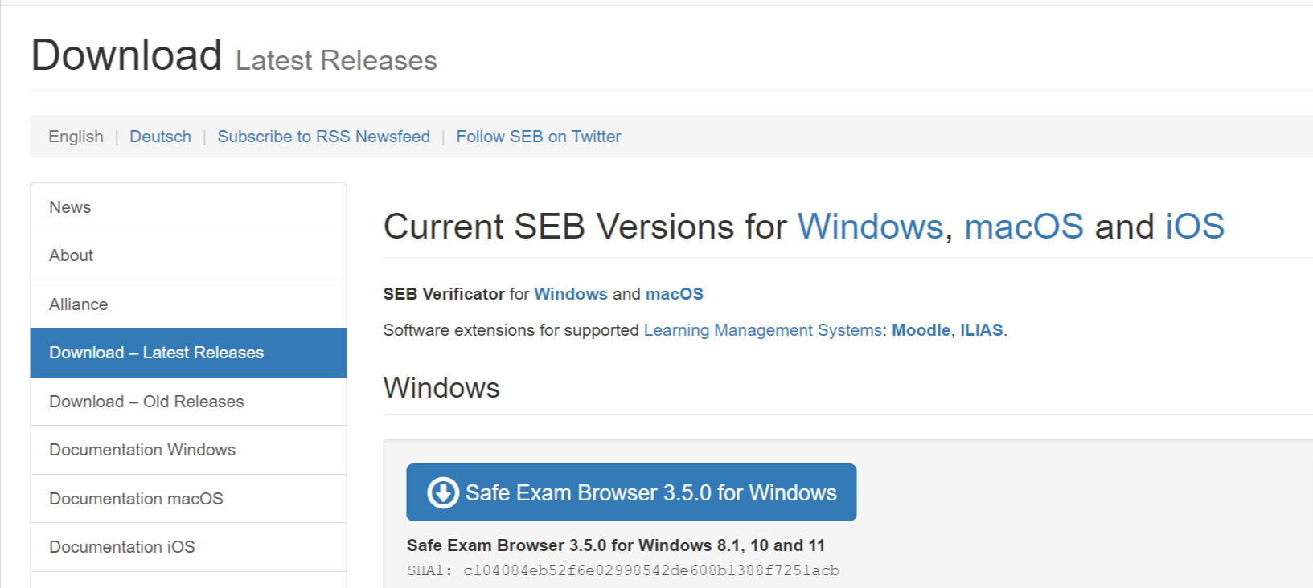
https://safeexambrowser.org/download_en.html#Windows)

Slide 7
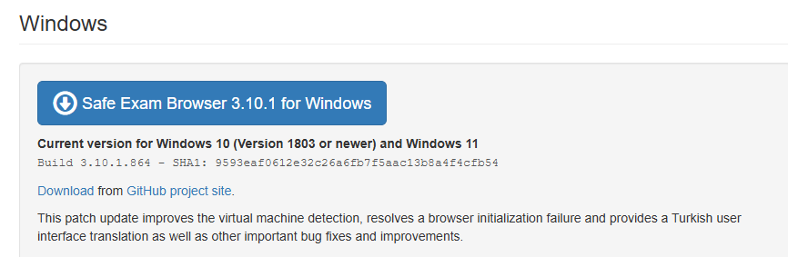
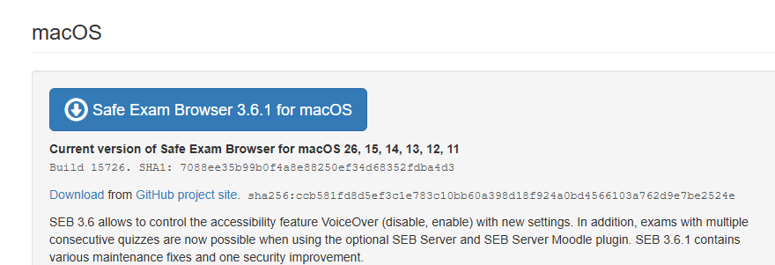
https://safeexambrowser.org/download_en.html#Windows)

Slide 8
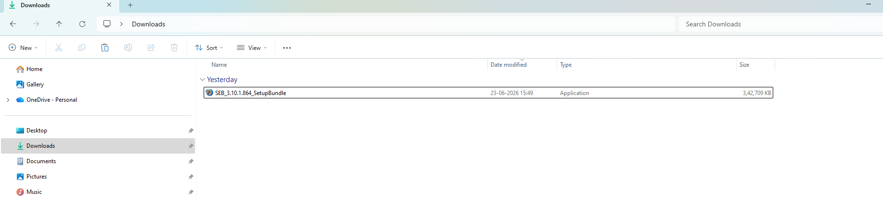

Slide 9
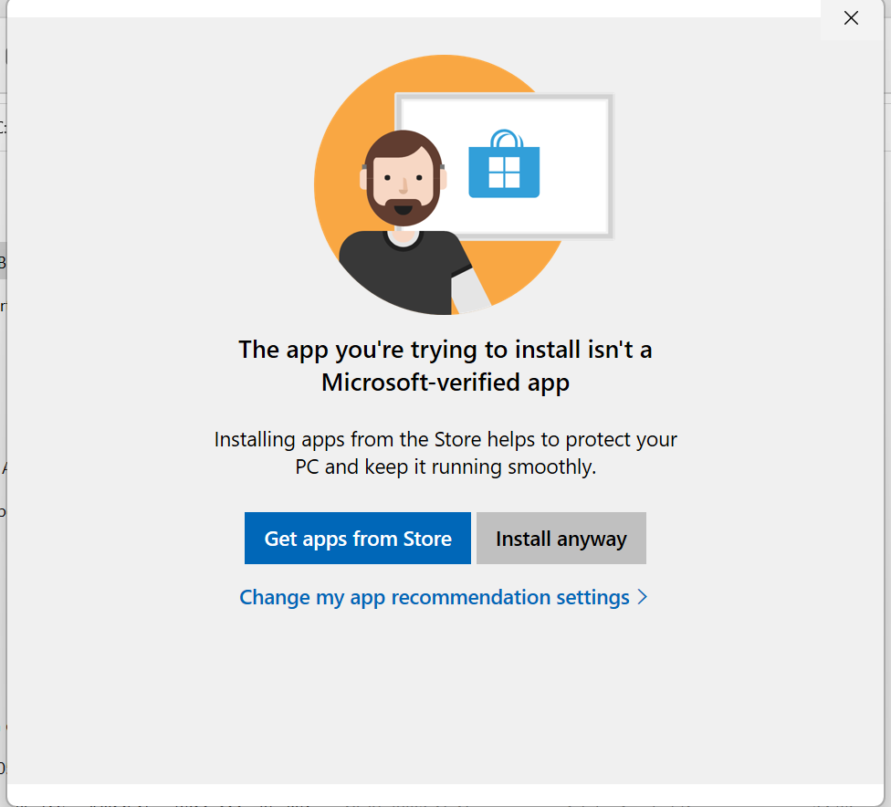

Slide 10
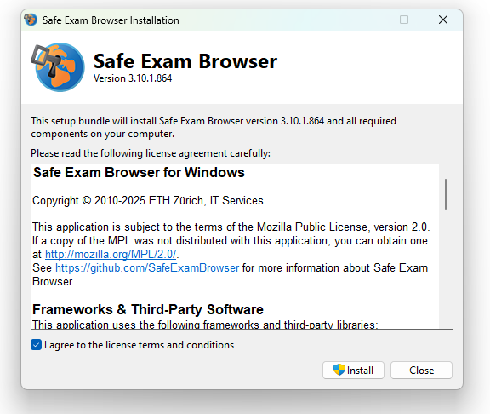

Slide 11
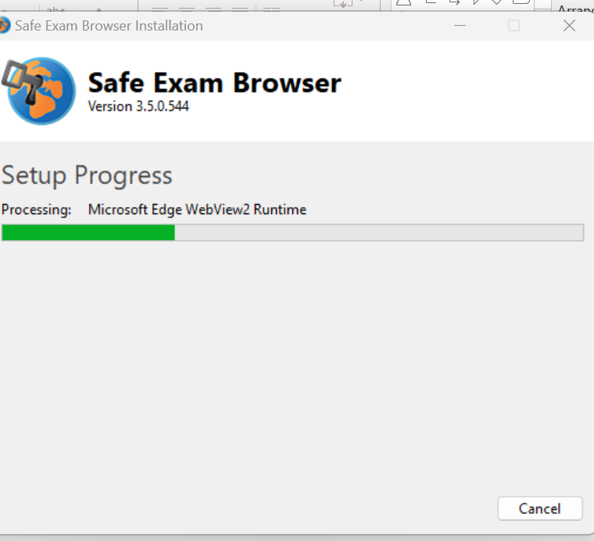

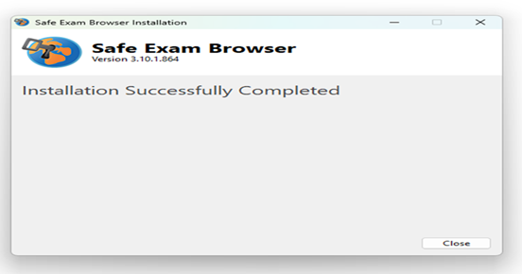

Slide 12
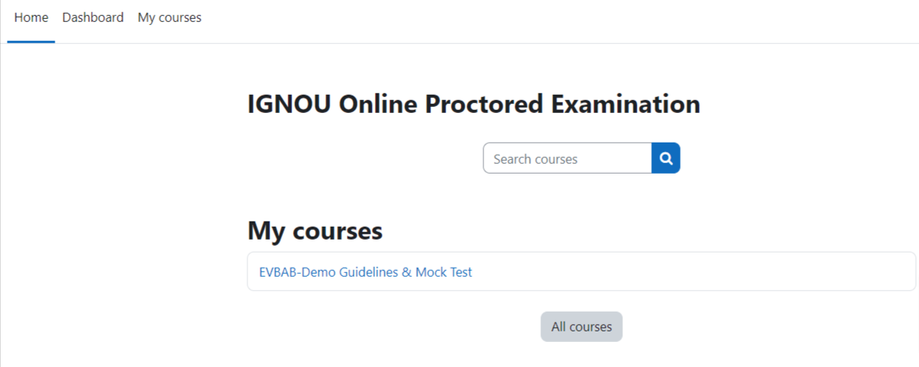

Slide 13
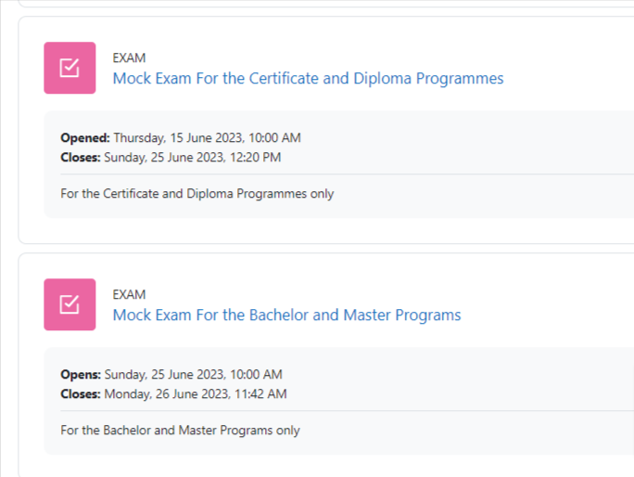

Slide 14
Profile Photo Update
(Steps 2 to 3)
URL: https://ignouexam.samarth.ac.in/

Slide 15
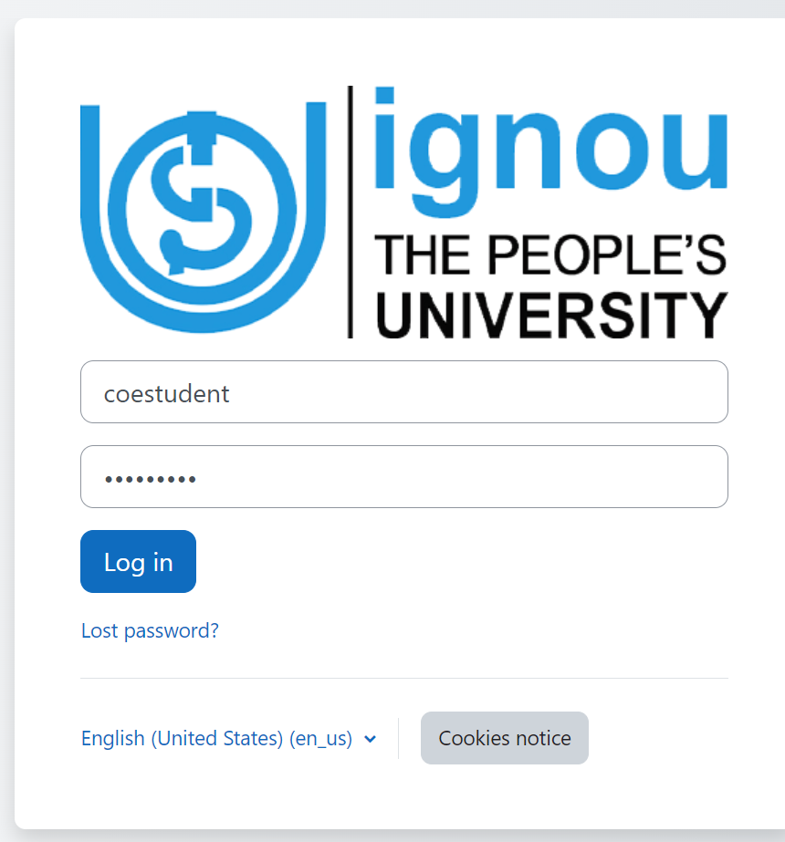
https://ignouexam.samarth.ac.in/

Slide 16
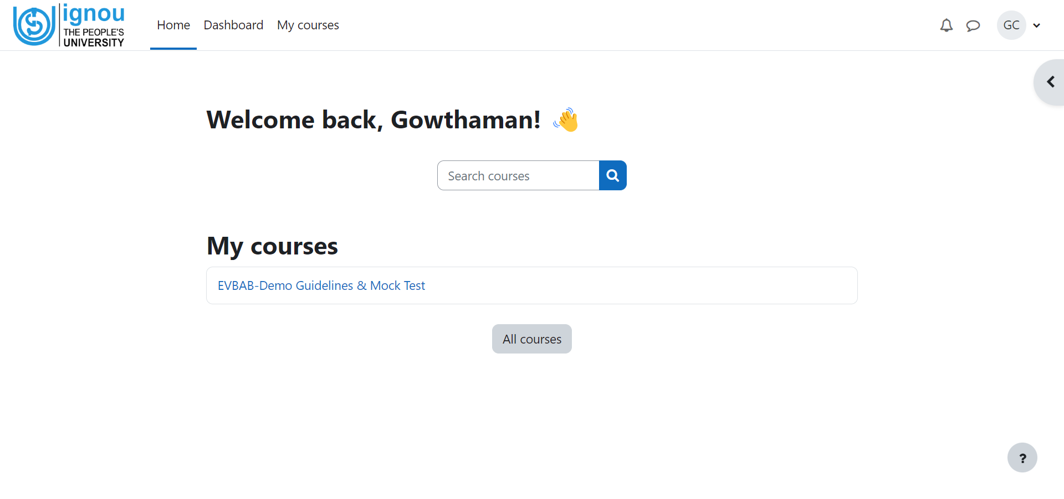

Slide 17
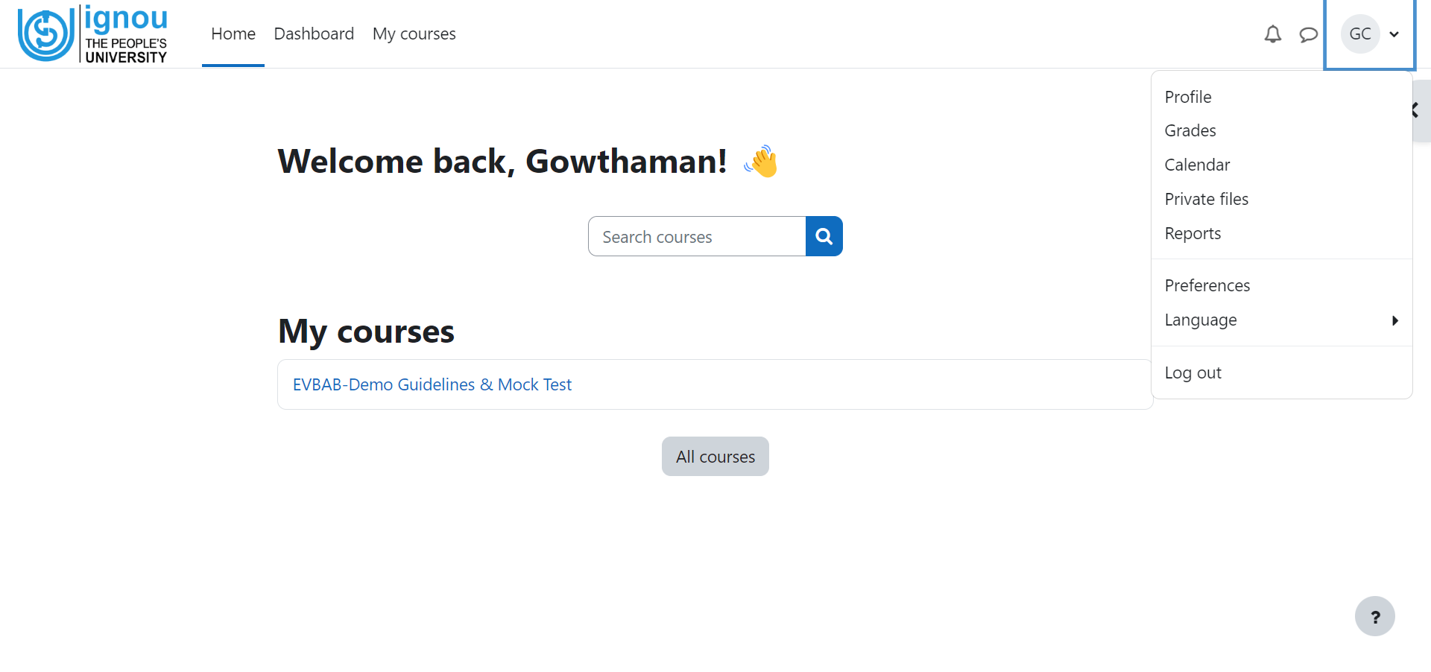

Slide 18
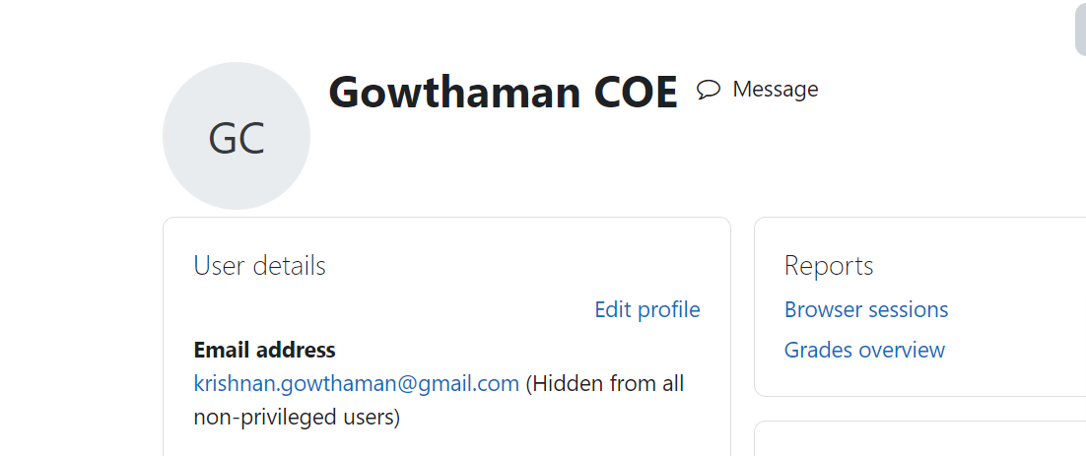

Slide 19
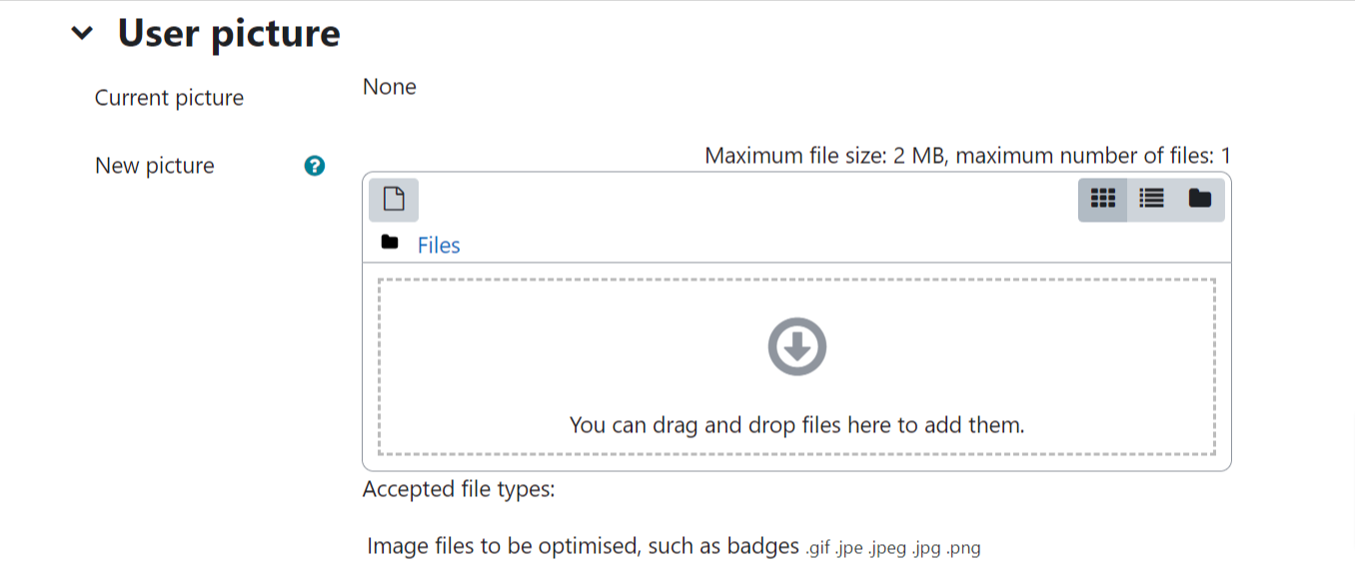

Slide 20
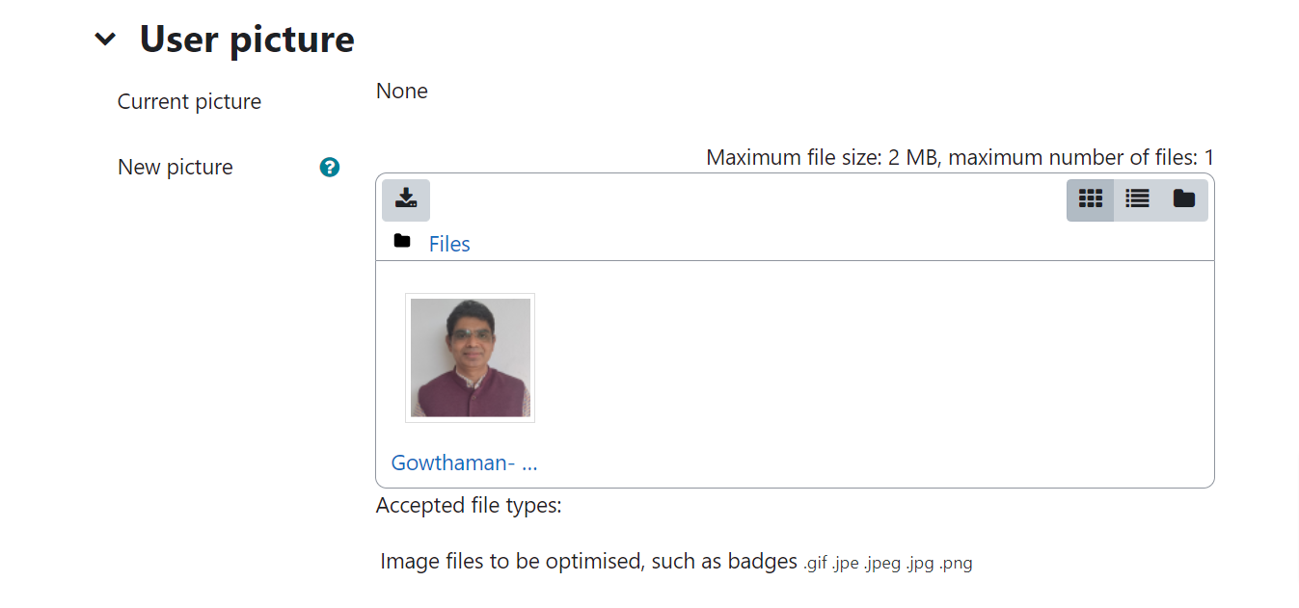

Slide 21
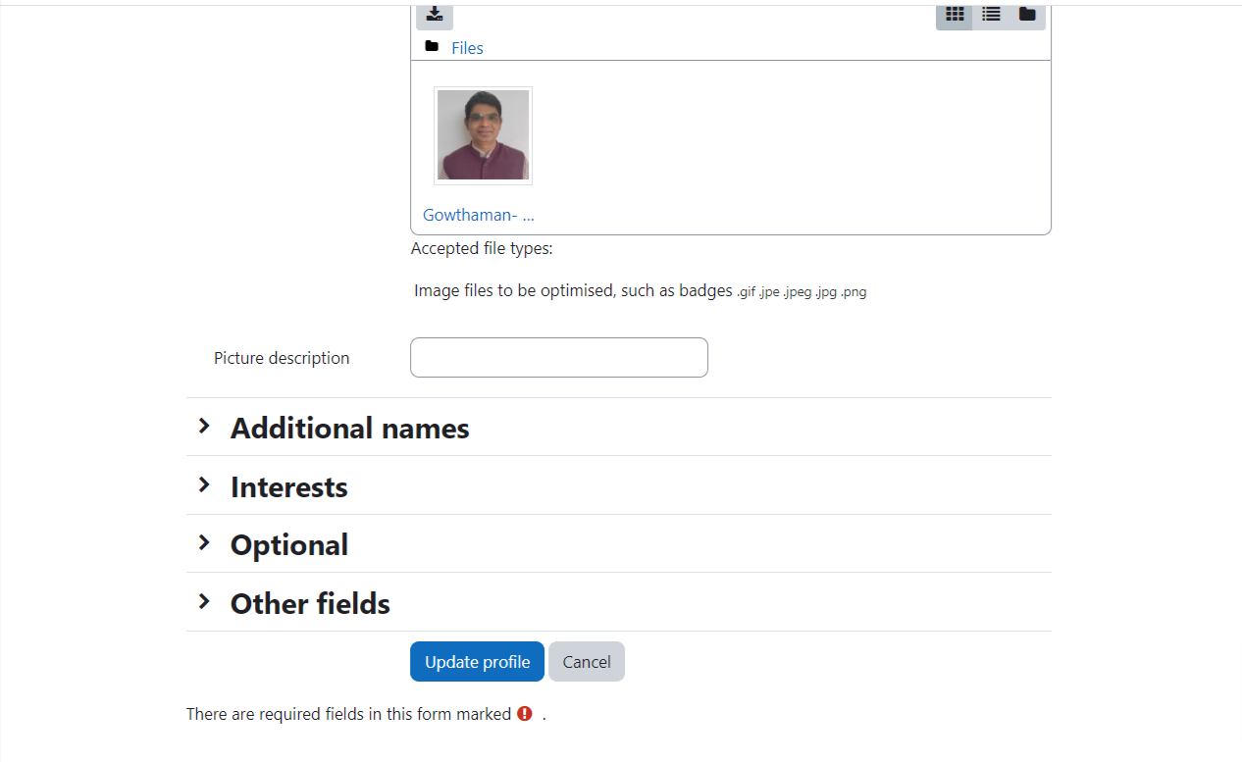

Slide 22
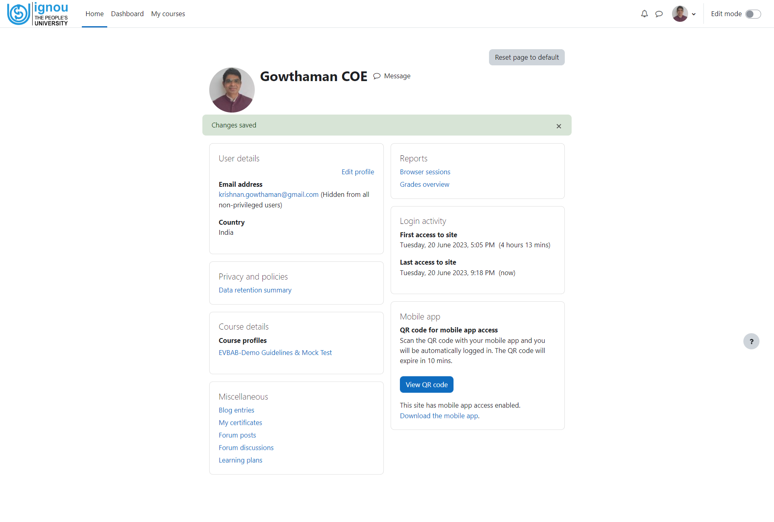

Slide 23
How to attend the examination?
(via safe exam browser) mcq type examination-demo
(Step 4-to-7)

Slide 26
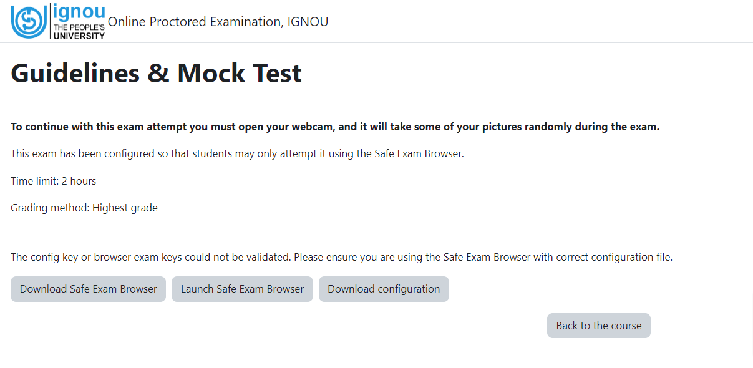

Slide 27
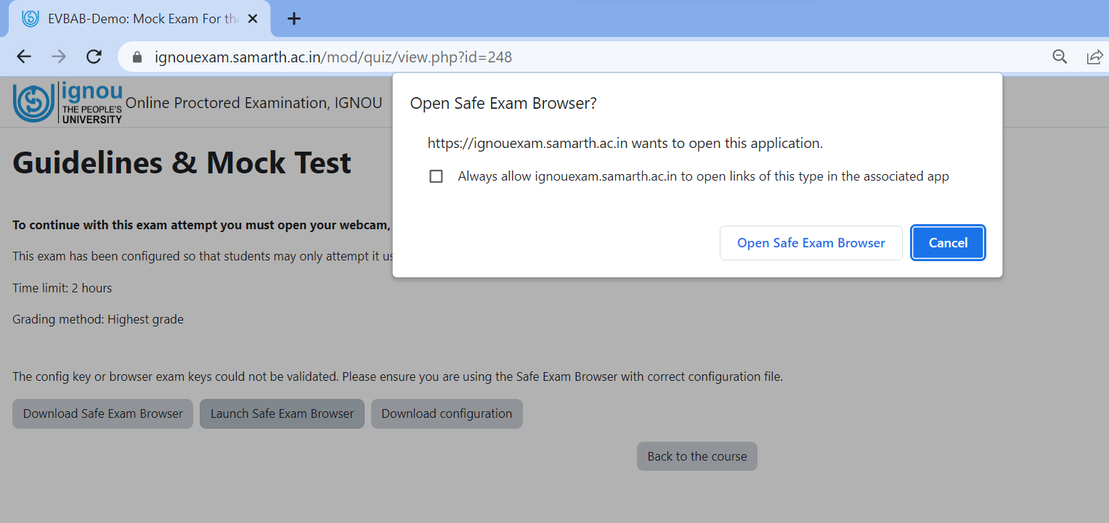

Slide 28
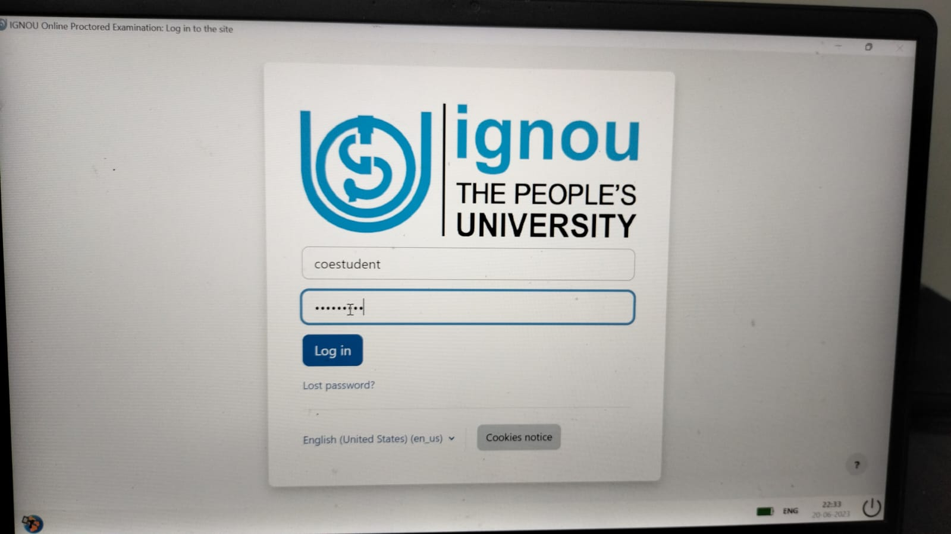

Slide 29
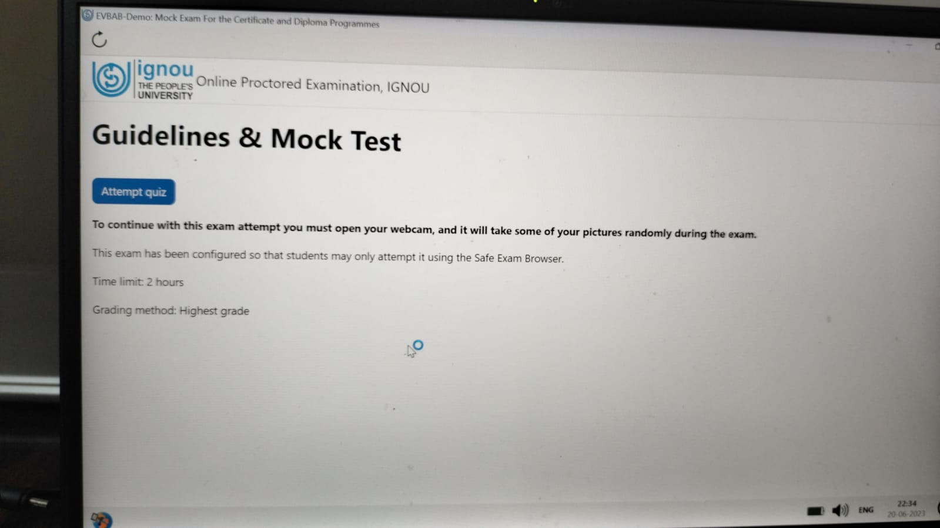

Slide 30
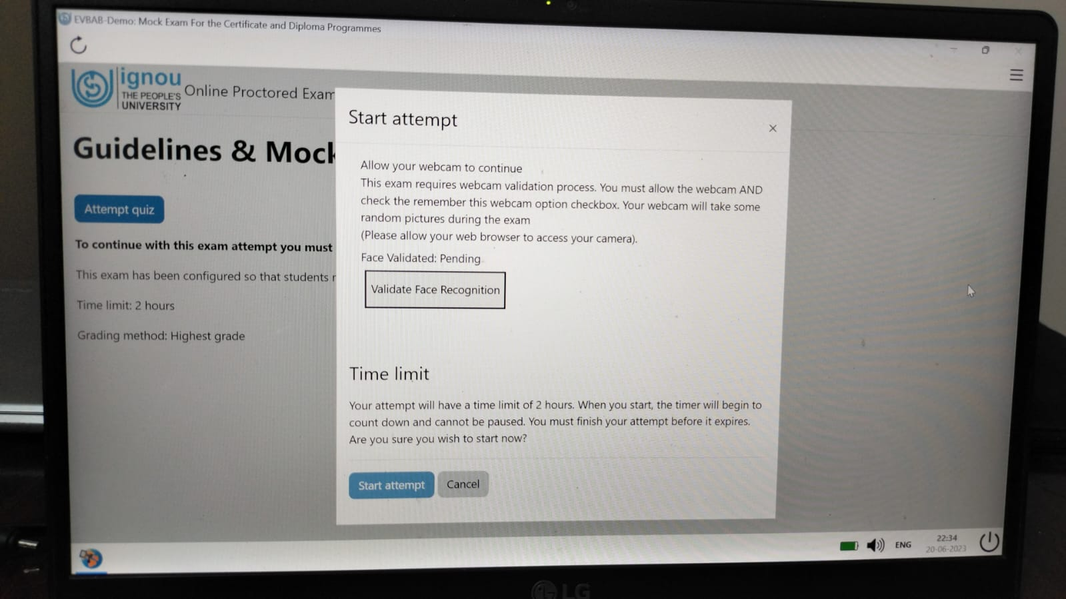
This is mandatory for examination

Slide 31
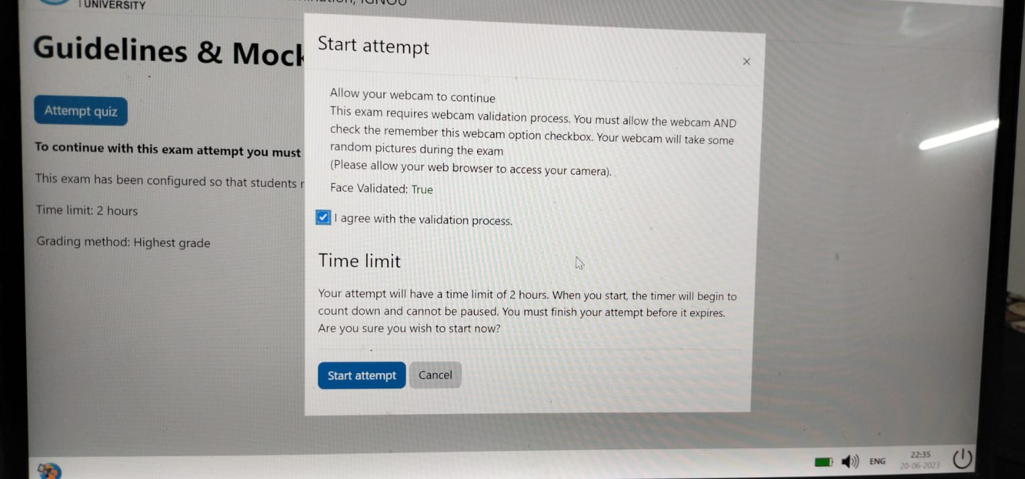

Slide 32
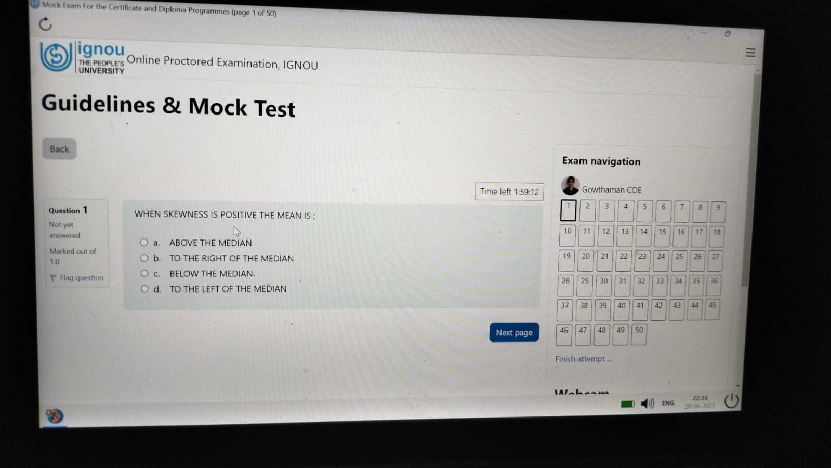

Slide 33
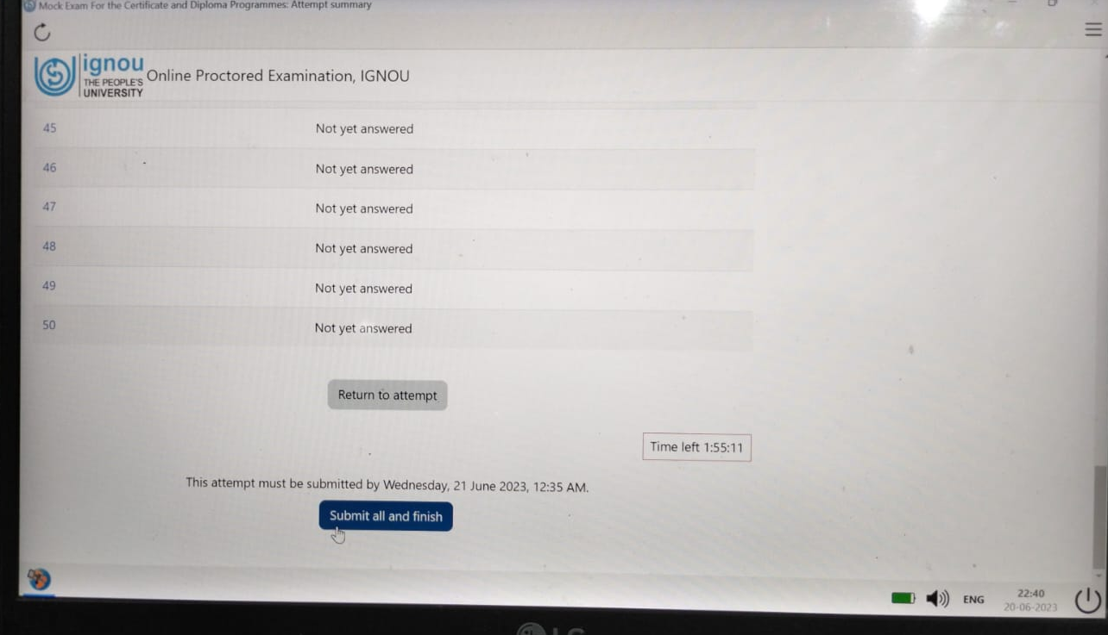

Slide 34
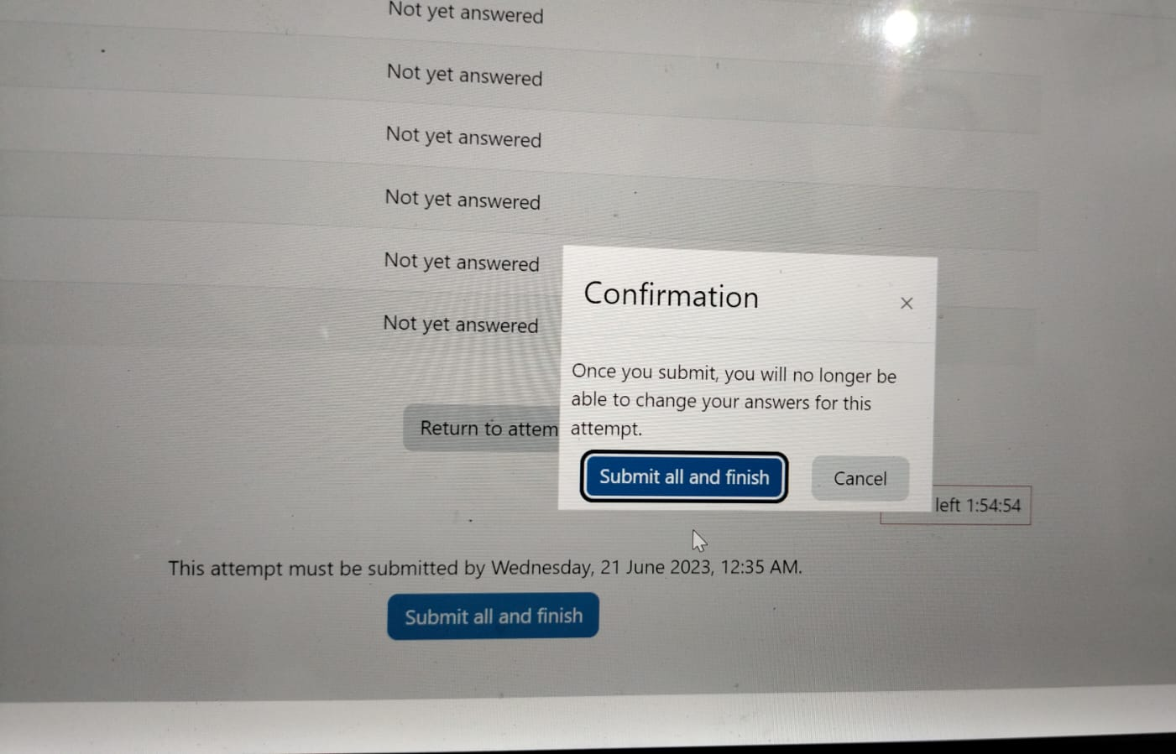

Slide 35
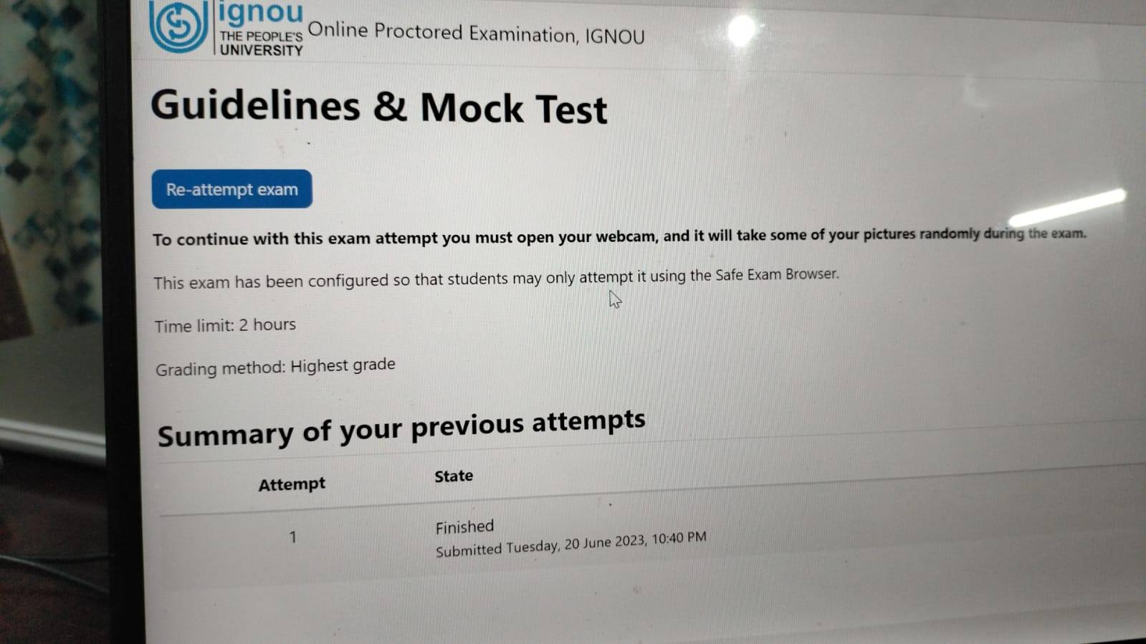

Slide 36
Appear the examination
(via safe exam browser)
Descriptive type examination-demo

Slide 38
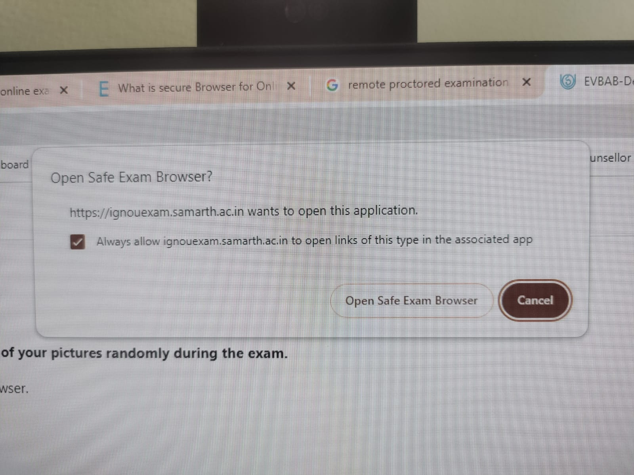

Slide 39
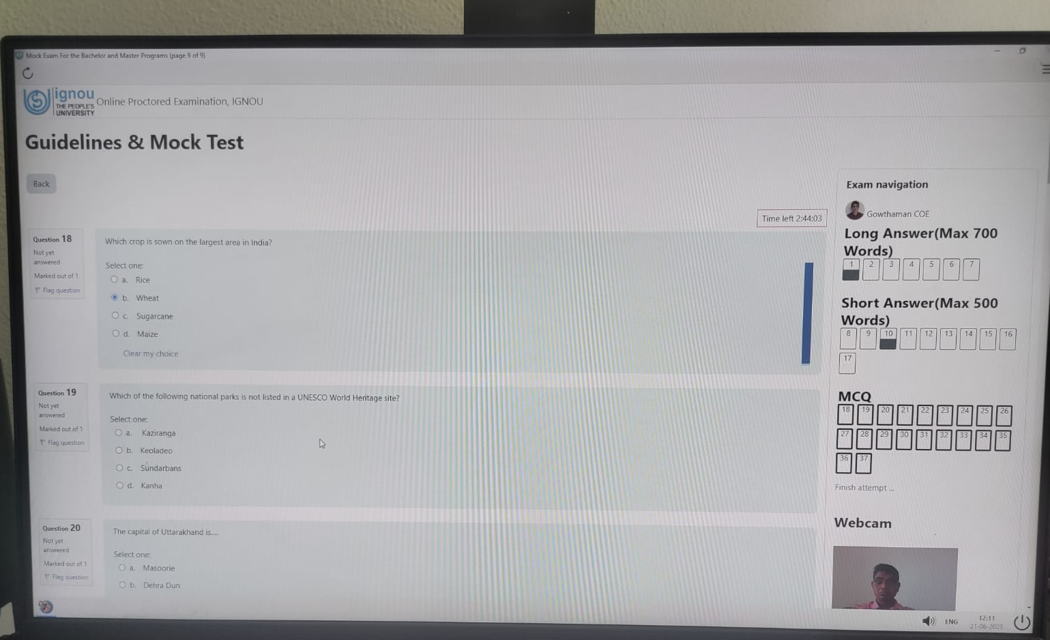
Descriptive type examination-demo

Slide 40
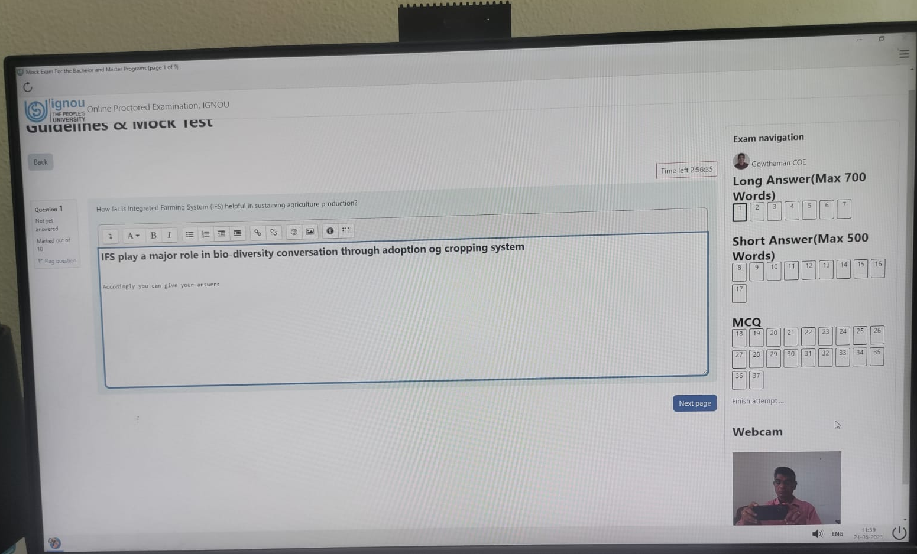
Descriptive type examination-demo
Type your answers here for above question

Slide 41
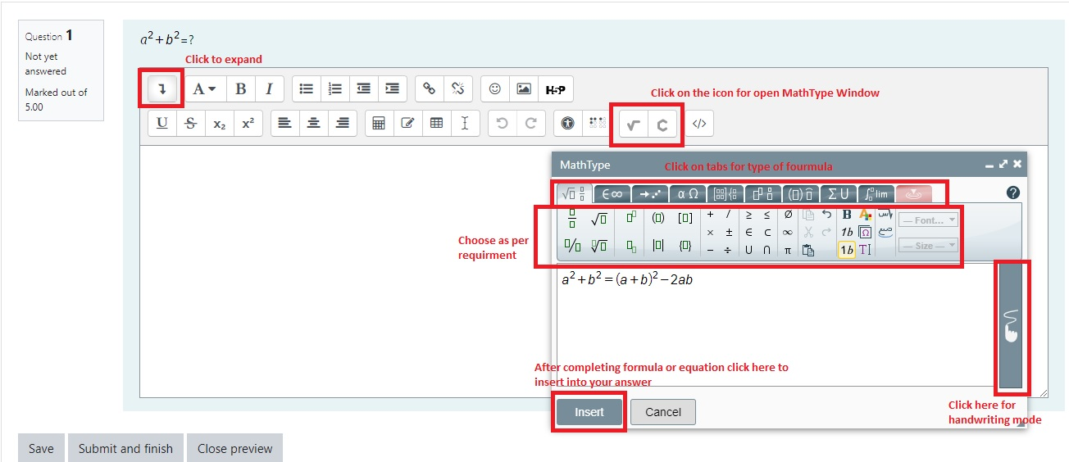
Instruction for Math and Chemistry tools

Slide 42
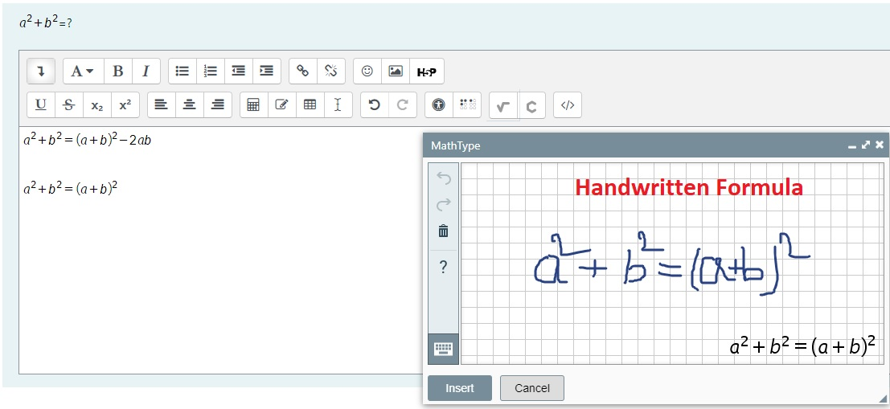
How to write handwritten formula for Math and Chemistry

Slide 44
Control and monitoring by ignou

Slide 45

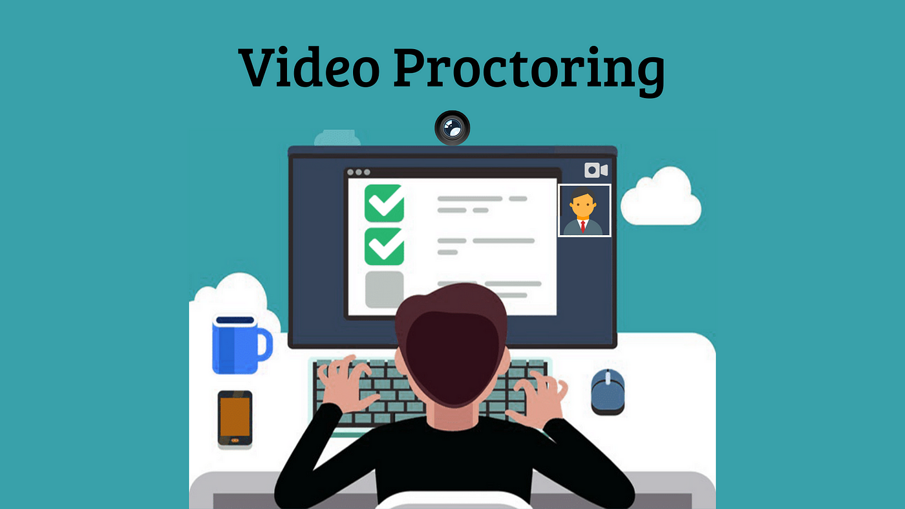
Control and Monitoring process & methods
SAMARTH Cloud based portal is used for Online proctoring examination purpose. This AI-based automated proctoring technology that uses students’ microphones and webcams for auto-invigilation.
Video Proctoring The webcam checks the students' faces, and the video is recorded. It raises flags if there is any suspicious activity visible in the video.
Audio Proctoring: The microphone records the audio of students. The proctoring system monitors the audio feeds and alerts the user if there is a new voice in the area.
Image Proctoring: It assesses and checks students’ pictures, which are taken at regular intervals, to check if there is any cheating activity.

Slide 46
Control and Monitoring process & methods
The Safe-Exam browser is a tool used as a part of remote proctoring (supervising) of the online exams. This feature prevents the students from opening any window or switching between different tabs.
It ensures that the candidate’s exam window is blocked and the only thing working or running is the examination tool. This helps to prevent the students from opening a new window or tab and thus secures the exam from unauthorized cheating.
This feature also blocks access to different shortcut keys such as cut, paste and copy. It can also stop any software running in the background which could possibly be used to capture screenshots or record the exam.
If the student tries to open a new window or change tabs or run any unwanted apps/software in the background, the secure browser immediately sends a warning message to the administrator.

Slide 47
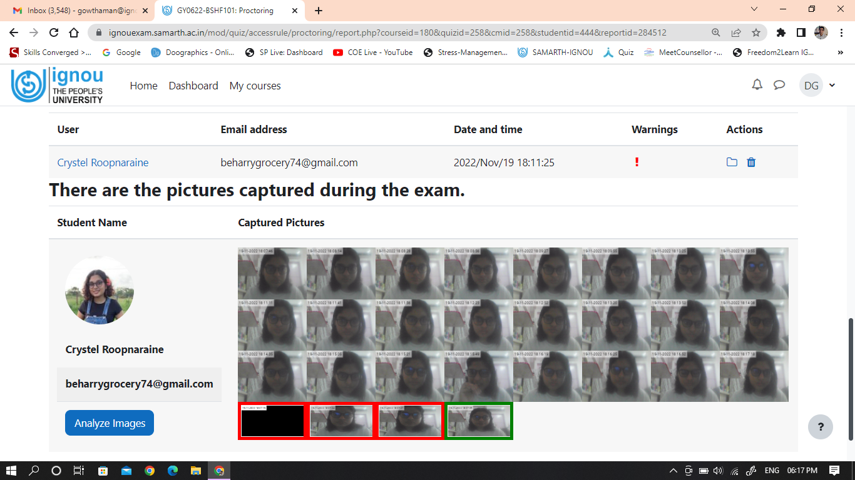
Control and Monitoring process & methods
AI Techniques

Slide 48
UFM (Un faIr Means)

Slide 49
What happens if I get UFM?
UFM or UnFair Means (UFM) is when you have tried to use unfair means such as chits, gadgets, or some other mode to score marks in a particular subject.
Such a situation can result in many scenarios: The result will be paused and postponed till the administration takes an action to solve the matter. The UFM Committee (Controller of the Examination, School Faculty and RSD ) will analyze the case and accordingly action will be taken as per University rules.

Slide 50
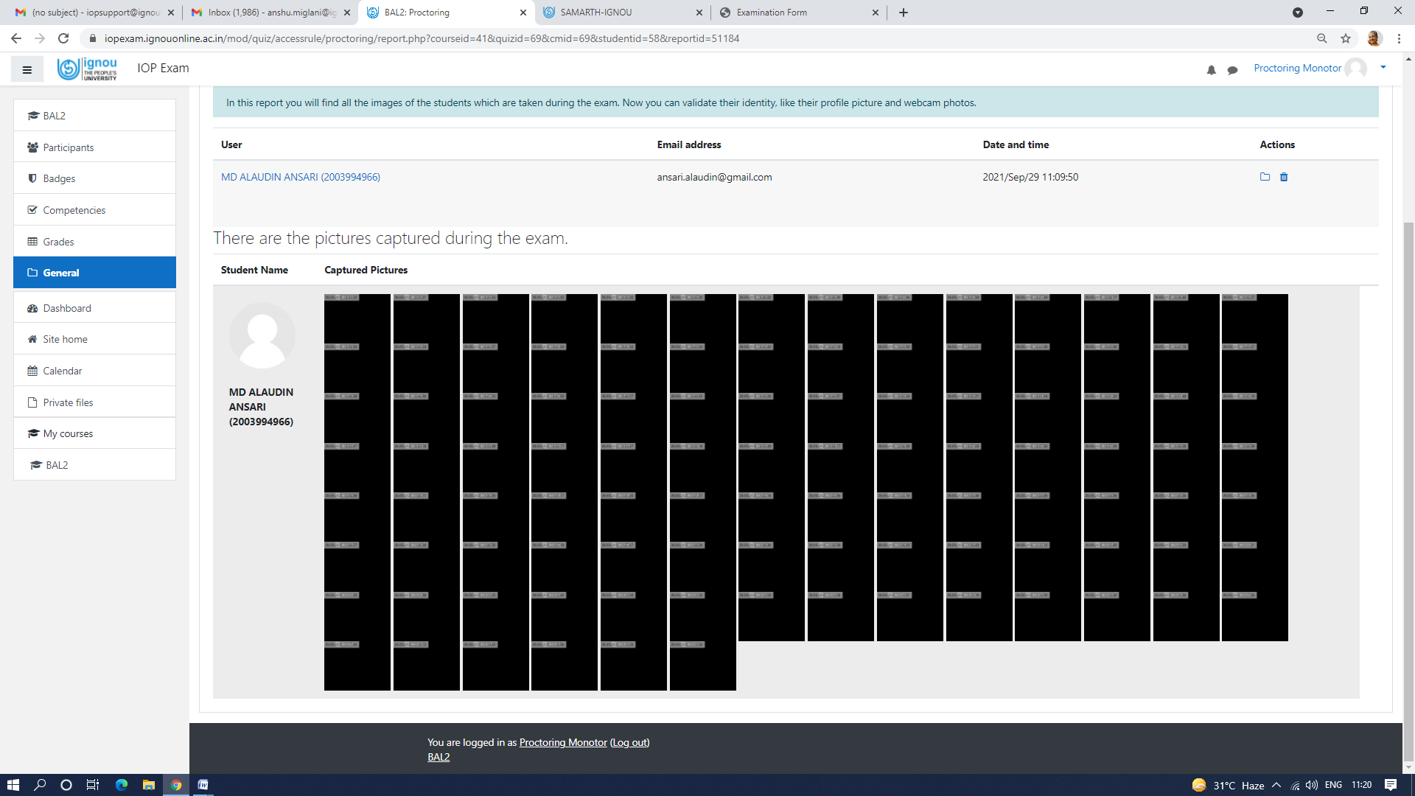
COE-Proctoring/ Monitoring: Few Challenges on observations
ENR. NO (XXXXXXXXXXX), NAME: Mr. YYYYYYYYYYY ZZZZ ( Hiding the Camera- UFM case)

Slide 51

All The best for your examinations thank You
Email: preexamevb@ignou.ac.in
preexamevb@ignou.ac.in

